Slide 1
Reusable Pods for ITS
Design & Manufacture pods to be attached onto ITS
Sriram Repaka(5403239)
Vandana Chegondi(530726)
Naga Sai Vamsi Uppuluri(5305739)
As part of :
Airbus Cafe SoSe2025
12.06.2025
‹#›

Slide 2
CONTENTS
Main use cases
Mission statement
Mission requirements
Overall operational concept
Overall system requirements
MVP/System design
Business case
Overall schedule
12.06.2025
‹#›

Slide 3
MAIN USE CASES
Although space exploration/travel has achieved great pace with regards to frequent rocket launches and continuous space exploration drives by many space organisations.
These space missions are often restricted by the fuel they can carry and the limited infrastructure of current technology for longer space missions to explore further parts of the universe
In order to allow for longer space explorations we need a system/infracture like an ITS, once the ITS is fully functional we need means to use it to the fullest and allow ourselves for space explorations
Enabling, Deep Space Exploration, Crewed Missions Support, Scientific Research Hubs, Cargo Transport & Logistics, Commercial Space Operations.
Each pod type is engineered for seamless ITS integration, autonomous docking, and mission-specific adaptability.

Slide 4
MISSION STATEMENT
To design and deliver advanced, modular space pods that seamlessly integrate with the ITS, enabling sustained, efficient, and mission-specific operations across deep space environments.
We aim to:
Maximize the operational potential of ITS infrastructure
Support diverse mission needs — from exploration and logistics to research and crew support
Pioneer scalable, reusable, and reliable pod systems for the next era of space travel

Slide 5
MISSION REQUIREMENTS
To ensure pods effectively support ITS-based space missions, the following key requirements must be met:
1. Functional Requirements
Seamless Docking with ITS: Autonomous and secure docking mechanisms compatible with ITS ports
Mission-Specific Modularity: Configurable interiors for exploration, cargo, crew, or research missions
Autonomous Operations: AI/remote control for navigation, diagnostics, and mission execution
Environmental Protection: Adequate shielding(thermal & radiation) for deep space environmental conditions also planetary gravity based mission changes.
2. User-Centric Requirements
Crew Safety and Comfort (if applicable): Ergonomic design, life support, emergency protocols
Easy Maintenance and Reusability: Modular components for quick refurbishment and turnaround
Payload Flexibility: Adjustable payload bays for varied mission needs

Slide 6
Overall operational concept
The operational flow outlines how ITS-compatible pods function across all mission phases, from launch to potential planetary landing:
1. Pre-Mission Preparation
Pod is configured for a specific mission (cargo, crew, science, etc.)
Systems tested and payload integrated on Earth
Launched via standard launch vehicle to reach ITS orbit
2. Docking with ITS
Autonomous navigation and docking
Secure mechanical and communication link established with ITS
3. Mission Execution Phase
ITS+pod provides refueling, resupply, and staging support
Pod proceeds to mission destination (e.g., satellite orbit, deep space, etc.)

Slide 7
Overall operational concept
4. Planetary Landing (if required)
Pod detaches from ITS or transit vehicle
Performs controlled descent and soft landing on planetary surface
Executes surface operations (research, habitat delivery, cargo drop, etc.)
5. Return or Redeployment
Pod may return to ITS for reuse or prepare for another destination
Data, crew, or samples transferred to return systems or storage
6. Post-Mission
Pod is inspected, updated, and reconfigured
Rapid turnaround for future missions due to modular design

Slide 8
Overall system requirements
To ensure full operational readiness and compatibility with the ITS infrastructure, the pod system must meet the following core requirements:
1. Integration & Compatibility
Fully compatible with ITS docking ports, power, and data interfaces
Interoperability with multiple mission modules (cargo, crew, science, etc.)
2. Modularity & Flexibility
Swappable modules for varied mission profiles
Tool-less reconfiguration of internal layout and payload sections
3. Autonomous Functionality
Software-assisted navigation, docking, and system-health monitoring
Remote command support with minimal Earth intervention

Slide 9
Overall system requirements
4. Structural & Environmental Resilience
Pressure-sealed and radiation-shielded structure
Operates in microgravity and extreme temperature conditions (-150°C to +120°C)
5. Power & Propulsion
Onboard power system with solar charging and battery backup
Propulsion system suitable for station-keeping, maneuvering, and optional planetary descent
6. Safety & Redundancy
Backup systems for critical functions (life support, power, navigation)
Emergency protocols for crewed missions, including abort and return options

Slide 10
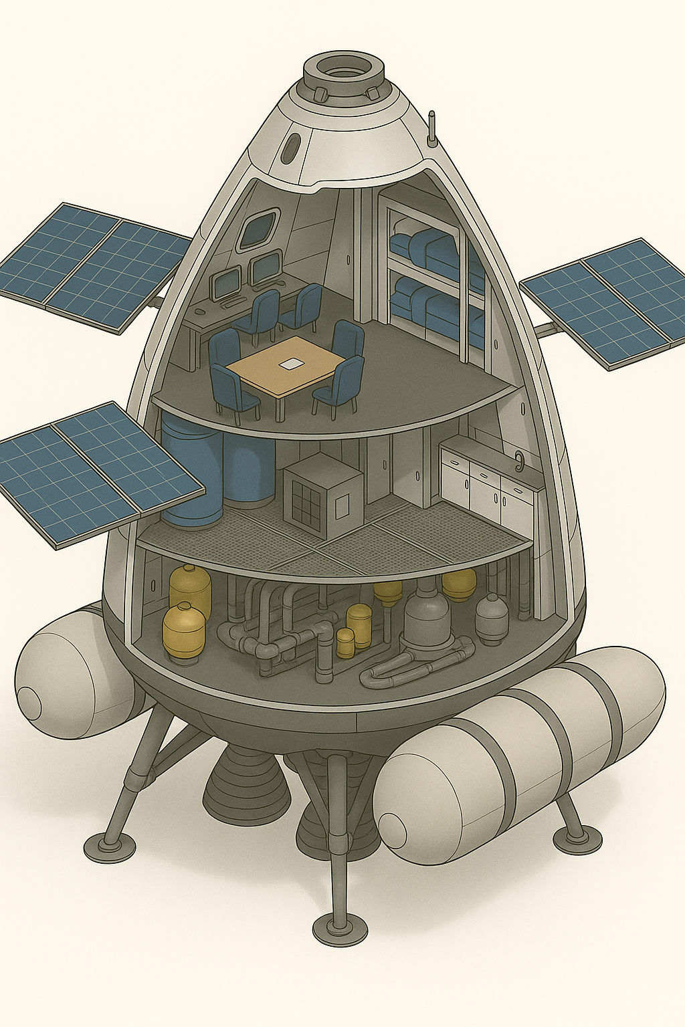
MVP/System design
Minimum Viable Product (MVP):
A modular, reusable crew habitation pod capable of supporting up to 6 astronauts for 60–90 days during interplanetary transit.
Core Features:
Modular cylindrical structure (~30m x 6m)
Private sleeping pods, hygiene station, medical unit
Life support: air recycling, water purification, temperature regulation
Universal docking interface with ITS core
Integrated artificial gravity system (rotational section due to ITS)

Slide 11
BUSINESS CASE
Market Opportunity: Rising demand for deep space infrastructure from agencies (ESA, NASA) and private space ventures (e.g., SpaceX, Axiom, Blue Origin).
Customer Segments:
Government space programs
Commercial space operators
Scientific research institutions
Value Proposition:
Reusable, modular pods reduce mission costs
Configurable for crew, cargo, or science roles
Compatible with future ITS-based transport systems

Slide 12
BUSINESS CASE
Revenue Model:
Direct sales and licensing
Long-term leasing and support contracts
Maintenance and upgrade services

Slide 13
OVERALL SCHEDULE
Project Duration: April – July 2025
🟩 Phase 1: Planning & Concept Development (Apr)
Define mission scope and pod subsystem
Assigned team roles and responsibilities
Drafted CONOPS and initial MVP concept
Identified key stakeholders and use cases
🟦 Phase 2: System Design & MVP Definition (May)
Designed internal layout and modular zones
Created 2D/3D MVP mockups
Defined high-level system requirements and backlog

Slide 14
OVERALL SCHEDULE
🟨 Phase 3: Review & Iteration (June)
Mid-term presentation (June 12)
Integrated mentor feedback
Refined MVP features and pod functions along with prototyping
Developed initial business case and risk map
🟥 Phase 4: Finalization & Delivery (July)
Final design diagrams and subsystem integration
Completed Business Model Canvas
Delivered final presentation (July 10)
Submitted final report and wrap-up (July 31)

Slide 15
Thank You!
31.01.2025
‹#›

